Slide 1
CLASS ROOM AUTOMATION AND AUTO ENERGY SERVER
MADE BY :
STUDENT’S NAME | REGISTRATION NUMBER
ATISHAY JAIN | 1031310650
ANIRUDDH SHAH | 1031310372
UDAY SHANKAR REDDY | 1031310655

Slide 2
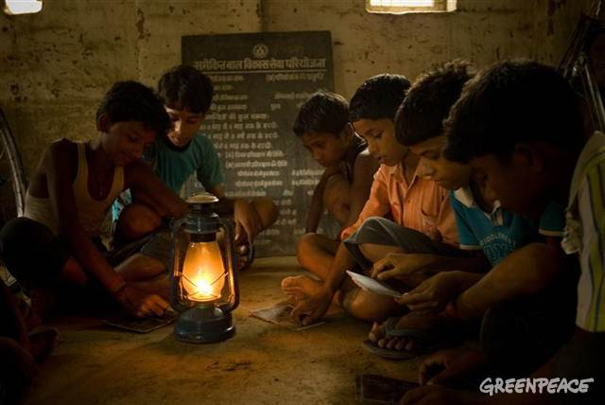
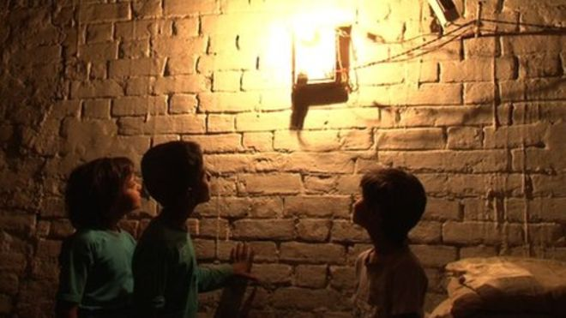
MOTIVATION
Electricity is the boon of science and technology to mankind. Its even hard for us to imagine a day without electricity. Yet, electricity is being wasted everyday in so many places especially in educational institutions where even after students leave the classroom, lights and fans are not being switched off.
On the contrary ,there are numerous number of villages in India where children still study with the help of “lanterns” and “candles”. So its our duty to conserve electricity so that every hook and nook of our country ,India gets lightened. This motivated us to develop a system where energy is being conserved.

Slide 3
OBJECTIVE
Class room automation will help to manage power consumption and wastage of electricity. This being the era of automation, students will be aided with automatic switching on and off of lights and fans, according to the strength of the class. Furthermore, after the class ends, lights and fans will be automatically switched off as the students disperse and leave the classroom. Thus electricity is saved from being wasted and doesn’t depend on students to switch them off thus saving time, energy and financial resources.

Slide 4
COMPONENTS
IR sensor
Arduino Kit
Bulb
Bread board
PCB
Battery
Wires
Relay

Slide 5
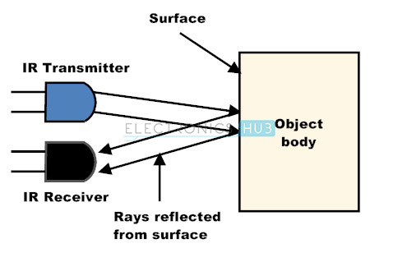
IR SENSOR
An infrared sensor is an electronic device, that emits in order to sense some aspects of the surroundings. An IR sensor can measure the heat of an object as well as detects the motion. These types of sensors measures only infrared radiation, rather than emitting it that is called as a passive IR sensor.

Slide 6
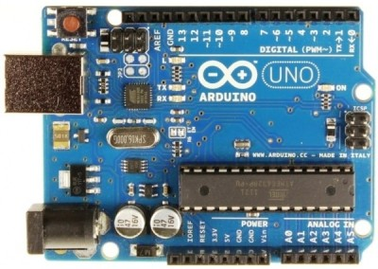
ARDUINO KIT
Open-source electronic prototyping platform allowing to create interactive electronic objects.

Slide 7
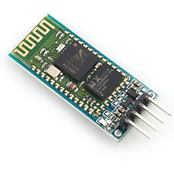
BLUETOOTH MODULE
This module is an easy to use Bluetooth SPP (Serial Port Protocol) module, designed for transparent wireless serial connections.

Slide 8

BULB
An incandescent light bulb, incandescent lamp or incandescent light globe is an electric light with a wire filament heated to a high temperature, by passing an electric current through it, until it glows with visible light.

Slide 9
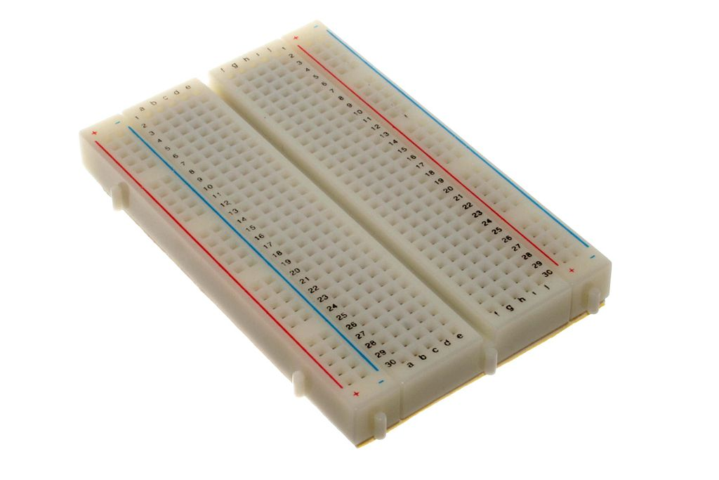
BREADBOARD
A breadboard is a construction base for prototyping of electronics ,it is reusable, it easy to use for creating temporary prototypes and experimenting with circuit design.

Slide 10
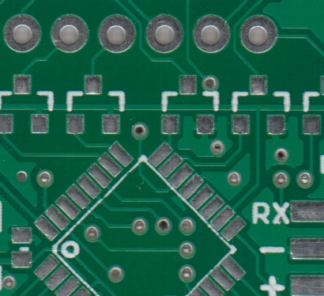
PCB(PRINTED CIRCUIT BOARD)
Printed circuit board (PCB) mechanically supports and electrically connects electronic components using conductive tracks, pads and other features etched from copper sheets laminated onto a non-conductive substrate, PCBs can be single sided (one copper layer), double sided (two copper layers) or multi-layer (outer and inner layers). Multi-layer PCBs allow for much higher component density. Conductors on different layers are connected with plated-through holes called vias. Advanced PCBs may contain components - capacitors, resistors or active devices - embedded in the substrate.

Slide 11
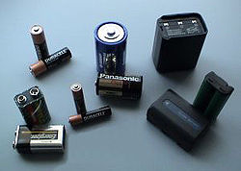
BATTERY
An electric battery is a device consisting of two or more electrochemical cells that convert stored chemical energy into electrical energy.

Slide 12
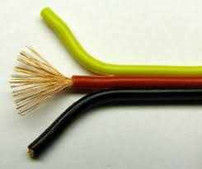
WIRES
A wire is a single, usually cylindrical, flexible strand or rod of metal. Wires are used to bear mechanical loads or electricity and telecommunications signals. Wire is commonly formed by drawing the metal through a hole in a die or draw plate.

Slide 13
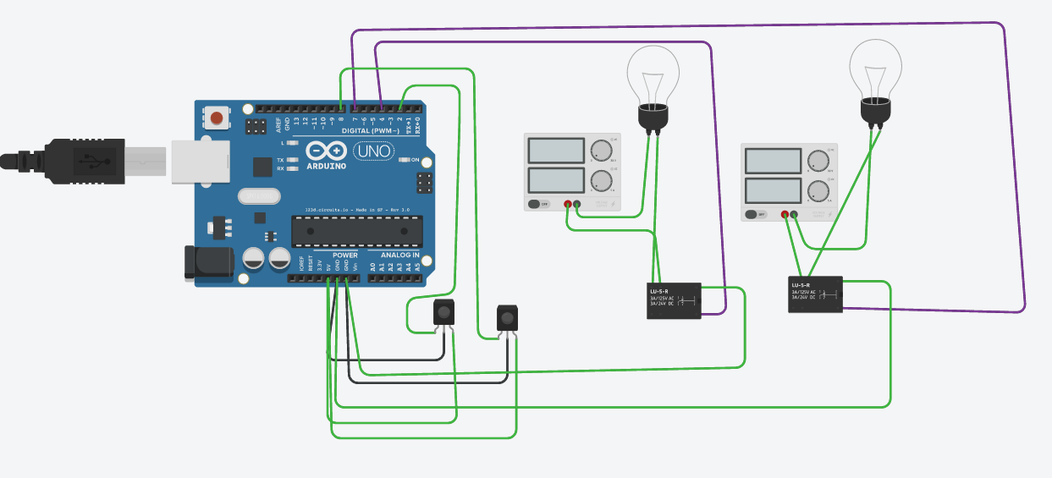
Lab View

Slide 14
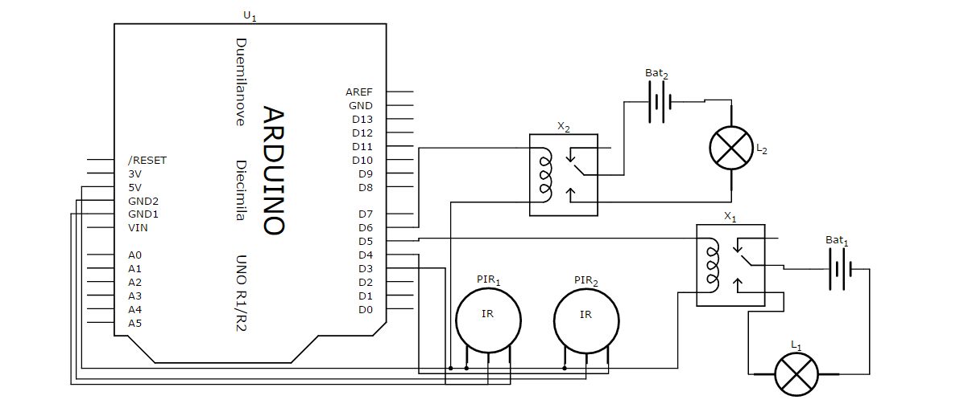
Schematic view

Slide 15
FUTURE SCOPE
Can be utilized on a larger scale in universities, offices, industries, schools.
We can improve the efficiency of work process and reduce the input mistakes.
We can interface this data to PC and send this data to a remote location using internet.
Voice alarm system can be added to indicate that classroom is full and persons cannot enter inside.

Slide 16
PROPOSED SYSTEM
Schools and colleges
Offices
Domestic use in houses
Domestic use in houses
Auditorium and hall for power saving purposes
Public park
Street light

Slide 17
CONCLUSION
Thus our project on “CLASSROOM AUTOMATIONSYSTEMS USING ARDUINO” provides a new system for reducing the electricity wastage across the globe using ARDUINO UNO microcontroller and INFRARED sensor .It has been proved to be a better system over the existing ones. It has increased reliability without increasing the cost of the system. Thus this new technology should be incorporated in our daily lives very soon so that the electricity wastage can be stopped to a greater extent. This system is not limited for any particular application, it can be used anywhere such as offices,industries,house. This concept not only ensures that our work will be usable in the future but also provides the flexibility to adapt and extend as need change .In this project work we have studied and implemented a complete working model using ARDUINO . The programming and interfacing of ARDUINO has been mastered during the implementation .This work includes the study of energy saving system in many applications.

Slide 18
THANK YOU

